Slide 1
Password Encryption using John the Ripper prepared by :SWATI(28320)

Slide 2
Password Cracking
The process of recovering Secret Passwords stored in a computer system or transmitted over a network.
There are many other tools available in Kali Linux that can help with this type of attack, so don’t be afraid to explore them.
John the ripper
Hydra
Hashcat
Ophcrack

Slide 3
Where would a password cracking tool be useful?
In your daily tasks as a cybersecurity professional, you may be asked to help a client identify the password of an email account or social media profile.
It’s important to understand that all passwords have strengths and weaknesses, so it is not enough just to try guessing them until you find the right one.
You will need tools like John the Ripper to crack those types of passwords to access a machine like this.
The John the Ripper tool is very powerful and it’s easy to use, which makes it perfect for everyday penetration testers.

Slide 4
John the Ripper
John the Ripper can be used to crack passwords from text files and word lists, also known as password dictionaries. It’s often one of the most important tools that anyone who wants to break into systems will need for performing password attacks.
The number of passwords available in your dictionary or word list will determine the size of the file, so the bigger the file, the more passwords it will contain.
After you’ve compiled the text files and word lists that contain passwords, simply pass them to John for processing.
Once a password has been identified as matching one of your texts or word lists, John will print out the username it belonged to and how many times it appeared in your list.

Slide 5

How to Crack Numeric Password for zip file
Create a password protected zip file in Linux.
Click on Create Archive and create a zip
file with password.

Slide 6
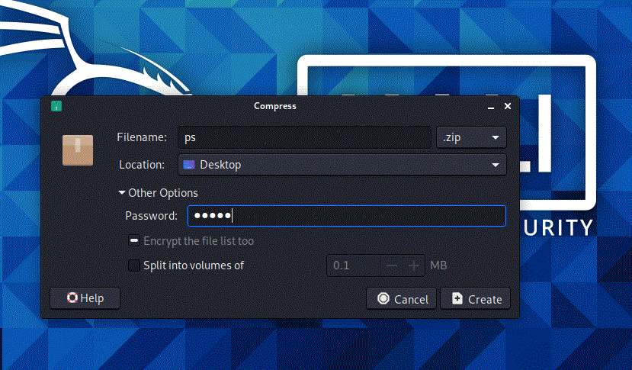
…
Click on create then a zip file will be created on desktop.

Slide 7
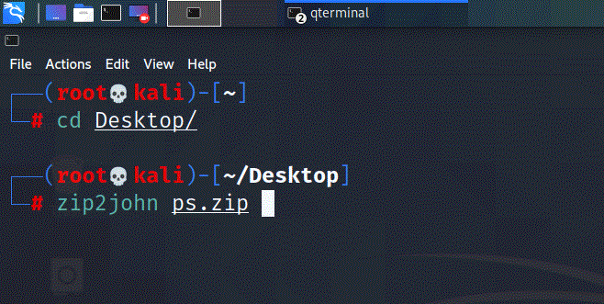
…
Open Terminal
1 >>cd Desktop
2 >>sudo zip2john filename.zip
OR
2 >> zip2john filename.zip
(This command will get and display encrypted password of a zip file )

Slide 8
3 >>zip2john ps.zip > pass.txt
This command will get password of filename “ps.zip” and export the result in filename “pass.txt”
To view the stored encrypted password enter command
4 >> cat pass.txt

Slide 9
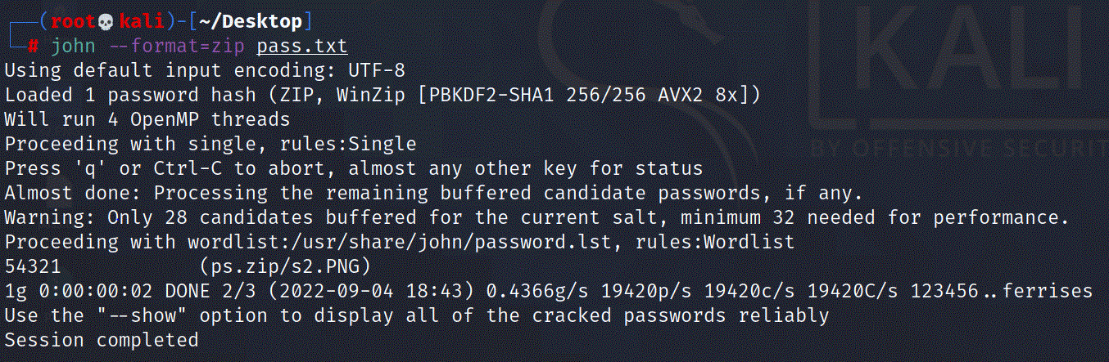
5 >> john - -format=zip pass.txt
This command will decrypt the password and display it on screen.

Slide 10
How to Crack Complex Password for rar file
Create a password protected rar file in Linux.
Click on Create Archive and create a rar
file with password(123ab).

Slide 11
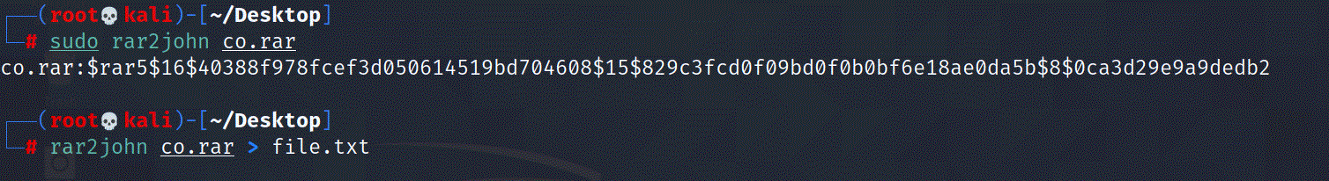
…
Open Terminal
1 >>cd Desktop
2 >>sudo rar2john filename.rar
OR
2 >> rar2john filename.rar
(This command will get and display encrypted password of a zip file )

Slide 12
3 >>rar2john co.rar > pass.txt
This command will get password of filename “co.rar” and export the result in filename “file.txt”
To view the stored encrypted password enter command
4 >> cat file.txt

Slide 13
5 >> john file.txt
This command will decrypt the password and display it on screen.
Note:- This password cracking method will
take very long time according to the
complexity of passwords.

